Slide 1
CyberSafeIreland
Group 4 Public Relations Plan

Slide 2
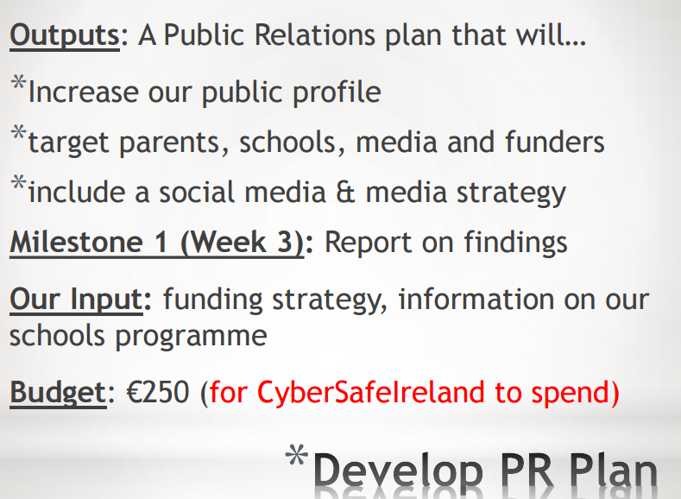
Introduction - Group 4 - PR Plan
We have got in contact with WebSummit, BT Young Scientist , The Irish Examiner and RTÉ in regards with talks and articles / shows.
We have yet to spend any of our budget and doubt we’ll need to spend much.
Possible investors include tech companies, universities, teaching organisations.
We have had a look at the possible DEIS schools in the Dublin area which could be used for launch.
Researched similar charities in other countries to draw on them for inspiration.
Gathered information and data to discover the best sites and means of communicating our message.

Slide 3
Similar Organisations
Many similar organisations around the world:
Childnet (UK)
Love Our Children USA
(ISC)² Foundation (Canada)
Cybersafeadvice.com – an Irish Website
Small numbers of social media followers – Childnet has 7000 on Facebook
Funding mainly from Tech organisations – Intel, Facebook, etc
Ribbon Selling
Awareness Days

Slide 4
Increasing Public Profile
Donations
Studies show that the average donor now considers a non-profit's cost of fundraising and administration before donating.
No more than 35% of funds should be spent on this.
65% then should be spent on program activities.

Slide 5
Increasing Public Profile
Our Image
Create an image; How do we want to be portrayed.
Logo
Certain Colours
Photos
Consistent Look throughout

Slide 6
Increasing Public Profile
Other Ideas
Share financial information with supporters.
Highlight Successes.
Thank Donors
Advertise them and also the fact that people are donating.
Win-win.

Slide 7
Social Media
Twitter
Relevant photos to get space on feed
Post links to our own website
Celebrity/News followers
Tweet early in morning / late in evening
Facebook
Limited audience (must pay Facebook directly to increase this)
Email lists could be useful
Facebook provides excellent analytics

